Slide 1


Emerging Adulthood
[Professor Name]
[Class and Section Number]
Notes:
Classroom Recommendations: This PowerPoint is presented in one 90-minute class but could also be taught in a two 50-60-minute classes. If teaching it in two classes, we recommend assigning the last activity “Current Trends in EA” to be done at home rather then during class.
Overview: The content focuses on understanding how EA has developed as well as the five major characteristics that make it distinct from other stages in life. The variations of EA are discussed between industrialized and non-industrialized countries.
Technical Note: These slides may contain simple click animation so that you can focus students’ attention on a particular question, a selection of text, or an image and not have them be distracted by reading ahead. You can either preview the sequence of animation by going through the slides in slideshow view, visiting the animations tab, or reviewing the slide notes. In the notes you will see a cue - (Click) – that corresponds to each animation.
You may also find hyperlinks to outside videos at various places in the slides. These hyperlinks are embedded in text and indicated by color and in the notes section.

Slide 2
Learning Objectives
Explain where, when, and why a new life stage of emerging adulthood appeared over the past half-century.
Identify the five features that distinguish emerging adulthood from other life stages.
Describe the variations in emerging adulthood in countries around the world.
Notes:
Purpose: This slide outlines the learning objectives of the module.

Slide 3
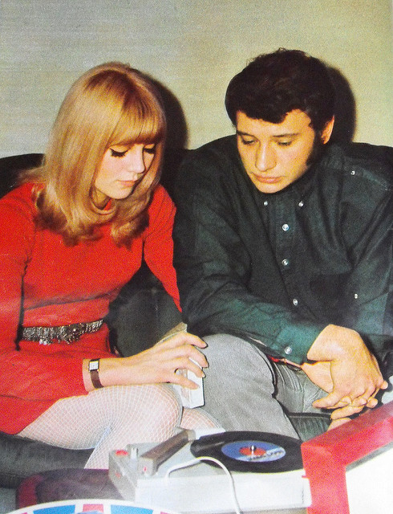
Warm up Activity: Possible Selves
Imagine you are 20 years old in the in the year 1960
Consider the following questions:
Where do you think you live?
Where do your parents live?
Do you work or go to school?
Where do you work or go to school?
What issues are important to you?
Are you in a relationship or single?
Do you have children?
Notes:
Purpose: This slide outlines a warm-up activity. This activity has students imagine their possible self as a 20 years-old in the year 1960. The student then compares this to who they were, or might be, in their real life at 20 years old. This activity is described in the IM under ‘Activities/Demonstrations.’ Please note: this activity is comprised of two slides – this one and the next, please move on to the next slide once your students have answered all the questions presented here.
Notes: Tell students to pull out a sheet of paper to make notes/answer questions on. This will not be collected.
(Click) Imagine that you are 20 years old in the year 1960.
Some students may not know much about the 1960’s. You can use the following web links to cover some quick fun facts about history or pop culture. https://www.census.gov/history/www/through_the_decades/fast_facts/1960_fast_facts.html
http://www.thepeoplehistory.com/1960.html
Note: If you are conducting this activity outside the United States, please conduct an online search and/or consult the archives of your country of residence for additional information about life in the 1960s.
(Click) Consider the following questions.
Have students write answers/ideas to the questions on the screen:
Where do you think you live?
Where do your parents live?
Do you work or go to school?
Where do you work or go to school?
What issues are important to you?
Are you in a relationship or single?
Do you have children?

Slide 4

Warm up Activity: Possible Selves
Reflect on your actual life at 20 years old
Consider the following questions:
Where do you live?
Where do your parents live?
Do you work or go to school?
Where do you work or go to school?
What issues are important to you?
Are you in a relationship or single?
Do you have children?
Notes:
Purpose: This slide is part two of the outlined warm-up activity.
Notes:
(Click) Reflect on your actual life at 20 years old have students answer the same question about their possible self currently, thinking either about their life when they were 20 or what it might be like when they are 20.
(Click) Consider the following questions.
Have students write answers/ideas to the questions on the screen
Have students pair with up with a peer to discuss their results. What similarities do they see between the two people they imagined? What differences exist?
Facilitate a class wide discussion where students can share their ideas with the larger group. List the differences between the 1960’s 20 year olds on the board with the actual 20 year olds. Make sure to touch on the differences in residency, jobs/school, and marriage/family. In the 1960’s young men and women were married, having children, and in the workforce in their early 20’s. Currently, these adult-like milestones are occurring in the late 20’s. Many are pursuing education and training beyond secondary school and are facing greater job instability in their early 20’s.

Slide 5
Overview
Introduction
Emerging adulthood (EA)
The Five Features of EA
International variations
EA in OECD countries: The advantages of affluence
EA in non-industrialized countries: low but rising
Conclusion
Notes:
Purpose: The purpose of this slide is to provide students with an overview of the material that will be covered during the lecture

Slide 6

What is Emerging Adulthood?
Emerging adulthood (EA) is a new stage of the life span, roughly between the ages of 18 and 25 that has arose over the past half-century in industrialized countries.
Notes:
Purpose: This slide is meant provide a definition for emerging adulthood.
Notes:
Emerging adulthood (EA) is a new stage of the life span, roughly between the ages of 18 to 25 (moving to 29) that arose over the past half-century in industrialized countries.
For more information on EA – from the Emerging Adulthood module:
“The theory of emerging adulthood proposes that a new life stage has arisen between adolescence and young adulthood over the past half-century in industrialized countries.”

Slide 7
Overview
Introduction
Emerging adulthood (EA)
The Five Features of EA
International variations
EA in OECD countries: The advantages of affluence
EA in non-industrialized countries: low but rising
Conclusion
Notes:
Purpose: Use this slide to transition from one major topic to another

Slide 8

Inventory of Dimensions of EA Scale IDEA-8
Complete the inventory
Notes:
Purpose: This slide instructs students to complete the IDEA-8 activity which is described in the IM under ‘Activities/Demonstrations.’, also refer to the Appendix to find the scale.
Notes:
(Click) complete the inventory: allow students 5 minutes to do so. Tell students this will not be collected but they will be scoring and working on their responses as the lesson continues.
When students are done they will not yet discuss responses. Students will be prompted to discuss their survey scores while covering the five features of EA in the next few slides.
“The Short Form of the Inventory of Dimensions of Emerging Adulthood (IDEA-8; Baggio et al., 2015) was developed as a shorter form of the original 31-item Inventory of Dimensions of Emerging Adulthood (IDEA; Reifman, Colwell, & Arnett, 2007), which assesses psychological issues associated with emerging adulthood. Exploratory factor analysis resulted in an 8-item, short-form scale (IDEA-8) with 4 factors: experimentation, negativity, identity exploration, and feeling in between. Confirmatory factor analysis showed that each item loaded significantly on the corresponding factors and that correlations between factors were medium or high. Support was found for construct and convergent validity, as well as high convergence with the initial scale. (PsycTESTS Database Record (c) 2015 APA, all rights reserved).”
PsycTESTS Citation:
Baggio, S., Iglesias, K., Studer, J., & Gmel, G. (2015). Short Form of Inventory of Dimensions of Emerging Adulthood. Retrieved from PsycTESTS. doi: http://dx.doi.org/10.1037/t42105-000

Slide 9
The Five Features of EA
The age of identity explorations
The age of instability
The self-focused age
The age of feeling in-between
The age of possibilities
1
2
3
4
5
Notes:
Purpose: The purpose of this slide is to introduce the students to the 5 features of EA.
Notes: There are five distinguishing characteristics of EA that separate it from other developmental periods. They are: The age of identity explorations, The age of instability, The self-focused age, The age of feeling in-between, and The age of possibilities.

Slide 10
The Five Features of EA
1
The age of identity explorations
Average questions 5 and 6 on your IDEA-8 scale
1 = strongly disagree
2 = somewhat disagree
3 = somewhat agree
4 = strongly agree
Compare your scores with your peers.
In what ways have you explored your identity?
Notes:
Purpose: The purpose of this slide is to cover the first of the 5 features of EA.
Notes:
(Click): The age of identity explorations: similar to Erik Erikson’s adolescent identity development, individuals in emerging adulthood are working to figure out who they are, what their strengths and weaknesses are, what they believe and value and how they fit into society.
(Click): averaging questions 5 and 6 gives the students a score on their “identify exploration.” Students scores will range from 1 to 4 and higher scores indicate that they are high in identify exploration during the current time in their life.
(Click): Instruct the students to compare their scores with peers who are around them. Are they high or low. Ask, “What does this look like for you?”
(Click): Lead a larger class discussion around this question ”In what ways have you explored your identity?” You are looking for responses that are typical of EA such as changing schools, majors, groups of friends, relationships and employment or career goals.

Slide 11
The Five Features of EA
2
The age of instability
Average questions 3 and 4 on your IDEA-8 scale
1 = strongly disagree
2 = somewhat disagree
3 = somewhat agree
4 = strongly agree
Compare your scores with your peers.
In what ways have you experienced instability?
Notes:
Purpose: The purpose of this slide is to cover the second of the 5 features of EA.
Notes:
(Click): The age of instability: marked by frequent changes in residence, education, work, and romantic relationships.
(Click): averaging questions 5 and 6 gives the students a score on their “instability.” Students scores will range from 1 to 4 and higher scores indicate that they are high in instability during the current time in their life.
(Click): Instruct the students to compare their scores with peers who are around them. Are they high or low? Ask “what does this look like for you”?
(Click): Lead a larger class discussion around this question ”In what ways have you experienced instability?” You are looking for responses that are typical of EA. For this one, keep in mind that instability causes stress, and can be a result of pressure from parents or society. Touch on these themes in your class discussion. Students might talk about stress figure out what to do for a career or for a major. They might talk about instability in their relationships or pressure they feel from their family.

Slide 12
The Five Features of EA
3
The self-focused age
What question might you add to the IDEA-8 that would reflect this feature?
Notes:
Purpose: The purpose of this slide is to cover the third of the 5 features of EA.
Notes
(Click): The self-focused age: individuals are establishing a more independent lifestyle, not relying on parents or embarking in marriage. Their focus is on themselves and they learn to make independent decisions.
(Click): This one is not reflected on our scale. Instead, ask students what question they might add to the scale that would reflect this feature? Have them share some sample questions with the class.

Slide 13
The Five Features of EA
4
The age of feeling in-between
Average questions 7 and 8 on your IDEA-8 scale
1 = strongly disagree
2 = somewhat disagree
3 = somewhat agree
4 = strongly agree
Compare your scores with your peers.
What does “feeling in-between” mean to you?
Notes:
Purpose: The purpose of this slide is to cover the fourth of the 5 features of EA.
Notes:
(Click): The age of feeling in-between: there is a feeling of being neither an adolescent nor an adult. Many feel a sense of transition.
(Click): averaging questions 5 and 6 gives the students a score on their “in-between feelings.” Students scores will range from 1 to 4 and higher scores indicate that they are high in feelings of transition during the current time in their life.
(Click): Instruct the students to compare their scores with peers who are around them. Are they high or low? Ask “what does this look like for you”?
(Click): Lead a larger class discussion around this question ”What does feeling in-between mean to you?” You are looking for responses that are typical of EA. For example, students might describe feeling lost, stuck, confused or overwhelmed. Others might feel good, as if they have a few more years to be free before settling down.

Slide 14
The Five Features of EA
5
The age of possibilities
Average questions 1 and 2 on your IDEA-8 scale
1 = strongly disagree
2 = somewhat disagree
3 = somewhat agree
4 = strongly agree
Compare your scores with your peers.
What possibilities lie ahead for you?
Notes:
Purpose: The purpose of this slide is to cover the last of the 5 features of EA.
Notes:
(Click): The age of possibilities: individuals are very optimistic about the various futures that are possible to them. They have high hopes and great expectations.
(Click): averaging questions 1 and 2 gives the students a score on their “age of possibilities” feature. Students scores will range from 1 to 4 and higher scores indicate that they are high in optimism during the current time in their life.
(Click): Instruct the students to compare their scores with peers who are around them. Are they high or low? Ask “what does this look like for you”?
(Click): Lead a larger class discussion around this question ”what possibilities lie ahead for you?” You are looking for responses that are typical of EA. Students might describe graduation, entering the work force, getting married and starting a family.
Conclude the larger discussion by stating that overall higher scores indicate that you are in EA or are feeling similar features to those that are in EA.

Slide 15
Overview
Introduction
Emerging adulthood (EA)
The Five Features of EA
International variations
EA in OECD countries: The advantages of affluence
EA in non-industrialized countries: low but rising
Conclusion
Notes:
Purpose: Use this slide to transition from one major topic to another

Slide 16
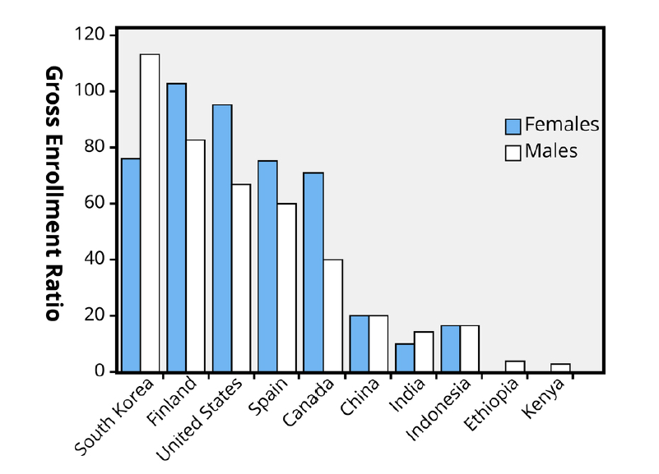
International Variations
Distinctions are made between OECD countries & non-industrialized countries.
Notes:
Purpose: The purpose of this slide is to introduce the international variations that exist in EA.
Notes: Distinctions are made between industrialized countries that are part of the Organization for Economic Co-operation and Development (OECD) and non-industrialized countries. OECD countries include Canada, western Europe, Japan, South Korea, Australia, and New Zealand among others. Non-industrialized countries include China, India, Indonesia, Ethiopia and Kenya among others. This figure shows the gross tertiary enrollment of people living in selected countries in 2007. Tertiary education is the third stage of education following high school or secondary education. A line exists showing the industrialized vs. the non-industrialized countries.
Figure Source: UNdata (2010). Note. Gross enrollment ratio is the total enrollment in a specific level of education, regardless of age, expressed as a percentage of the eligible official school-age population corresponding to the same level of education in a given school year. For the tertiary level, the population used is that of the five-year age group following the end of secondary schooling.

Slide 17

OECD Countries
Tertiary education
Mean age of marriage & parenthood
Low or free costs
Generous social welfare systems
Individualism vs. Collectivism
Family influence
Sexuality
Notes:
Purpose: The purpose of this slide is to continue to cover the international variations that exist in EA
(Click): Tertiary education
(Click): Mean age of marriage & parenthood
(Click): Low or free costs
(Click): Generous social welfare systems
OECD countries show similar trends to the United States in participation of postsecondary education, median ages for entering marriage, and parenthood. EA is the longest in European countries where individuals take advantage of free tertiary education, job location assistance, unemployment benefits and housing support. Asian countries also have generous social welfare systems that provide support to people within EA allowing them ample transition time.
(Click): Individualism vs Collectivism
(Click): Family Influence
(Click): Sexuality
However differences exist. Europe’s history of individualism reinforces the focus on the self and financial independence while Asian cultures value collectivism and emphasize family obligations such as the capability to support parents financially. Thus, parents in Asian countries have a more influential say in EA’s studies, job selection and living arrangements. Another striking difference is in sexuality. Premarital sex and cohabitation are common among western EA’s, which are both rare or forbidden throughout much of the rest of the world.

Slide 18

Non-Industrialized Countries
Low but rising
Globalization & economic development
Notes:
Purpose: The purpose of this slide is to continue to cover the international variations that exist in EA
(Click): Low but rising
Within non-industrialized countries only a minority of individuals, mainly from the urban middle class, are experiencing EA. The majority still marries in the early 20’s and do not pursue tertiary education.
(Click): Globalization & economic development
As globalization and economic development continues to grow so too will the number of individuals who experience EA.

Slide 19
Current Trends in EA
OECD Countries
South Korea
Finland
Non-Industrialized Countries
China
Kenya
United States
Spain
Canada
India
Indonesia
Ethiopia
Directions
Make small groups (3-4 students)
Using the internet research for your assigned country
Answer the questions on the handout (20 minutes)
Share your answers with the class
Notes:
Purpose: This slide instructs students to participate in the “current trends in EA” activity which is described in the IM under ‘Activities/Demonstrations.’ Please note: the next slide also contains a wrap-up discussion on current trends in EA, please go to the next slide when you are finished with all the activity steps on this one.
Please note: This activity requires internet access.
Notes:
Assign students to teams of 3 students (or more depending on class size). Assign each group of students a country. Make sure to assign both non-industrialized and industrialized countries to the class.
Instruct students to use the internet to answer the following questions about their country:
What is the current rate for individuals entering tertiary education?
What is the current average or median age for entering marriage?
What is the current average or median age for having children?
How many career changes do individuals go through, on average?
What source did you use to gather this information?
Share the results as a large class. To facilitate the sharing process you can go question-by-question or you can have students write all their responses on the board and cover them country by county. Based on the numbers found, identify if the countries are experiencing EA or not.
Continue on to the next slide for the last portion of this activity →

Slide 20

Current Trends in EA
Do the current trends in EA, within the various countries researched, match the reported thoughts from the module?
Notes:
Purpose: This slide finishes the “current trends in EA” activity.
Notes:
4. Reflect on the responses by asking the following discussion question.
Do the current trends in EA, within the various countries researched, match the reported thoughts from the module?
Ask the following probing questions:
How are they similar?
How are they different?
What do you expect to see in the coming years?

Slide 21
Overview
Introduction
Emerging adulthood (EA)
The Five Features of EA
International variations
EA in OECD countries: The advantages of affluence
EA in non-industrialized countries: low but rising
Conclusion
Notes:
Purpose: Use this slide to transition from one major topic to another

Slide 22
Conclusion
Increased reliance on parents
Ample time for education
Emerging Adulthood
Delay in contribution to society
Mature decision making
Notes:
Purpose: The purpose of this slide is to conclude the lesson by comparing the positive and negative outcomes of EA.
Notes:
The negative impact of EA is the increased reliance on parents and the delay it takes individuals to become contributing members of society.
Advantages include ample time to obtain the education needed to meet the demands of today’s information and technology-based economy as well as more mature judgment-making in regard to life and love.
To support EA, countries should expand opportunities for tertiary education and reduce its costs.

Slide 23

CAT: Student-Generated Test Questions
Student Generated Test Questions:
Write one multiple-choice question about EA. Answer the question and write a rationale for the question.
Submit your work by the end of class.
Notes:
Purpose: Use this CAT to conclude class and to obtain feedback from students about the content of the lesson.
Notes: Use the Classroom Assessment Technique “Student Generated Test Questions” to assess students understanding of the material covered in this lesson. Students are asked to write 1 to 3 multiple-choice questions. Decide on the number of questions based on how much time you have available at the end of the class. Students should then answer the question and provide a rationale for the answer. A variation could be to have students write a short answer or essay questions. They can also take the questions home to answer them, or trade with a partner and answer the partner’s question. All or some of the questions can be used on the next quiz or exam.
Source: Angelo, T. A., & Cross, P. K. (1993). Classroom assessment techniques: A handbook for college teachers. San Francisco, CA: Jossey-Bass.
If you do not conclude with this Classroom Assessment Technique (CAT), it would helpful to use another CAT. It could be in the form of a:
Muddy point
One-minute paper
Background knowledge
What’s the Principle?
Defining features Matrix:
For more information on CATs click here: http://cft.vanderbilt.edu/guides-sub-pages/cats/

Slide 24
Appendix A&B
Student handouts for IDEA-8 and Current Trends in EA activities. Click icons to open.

Slide 25
Photo Attribution
Slide 1 | Photo Credit: Young People karosieben https://pixabay.com/en/young-people-forward-uncertainty-737150/ https://creativecommons.org/publicdomain/zero/1.0/deed.en
Slide 3 | Photo Credit: Photo Credit: Parisian Couple tiffany terry https://www.flickr.com/photos/35168673@N03/3727362530/ https://creativecommons.org/licenses/by/2.0/
Slide 4 | Photo Credit: Couple in living room smiling Richard foster https://www.flickr.com/photos/93963757@N05/8550837925 https://creativecommons.org/licenses/by-sa/2.0/
Slide 6 | Photo Credit: 5 Fs Rachel Kramer https://www.flickr.com/photos/26503922@N08/6281459192/ https://creativecommons.org/licenses/by/2.0/
Slide 8 | Photo Credit: PO-untitledIMG_0415_09-04-13.jpg Armando Tura https://www.flickr.com/photos/98067729@N03/9696521127/ https://creativecommons.org/licenses/by-nc-sa/2.0/
Slide 16 | Photo Credit: Noba Staff
Slide 17 | Photo Credit: Le Défilement du Temps Adrien Leguay https://www.flickr.com/photos/52783780@N03/8257932756/ https://creativecommons.org/licenses/by-nc-nd/2.0/
Slide 18 | Photo Credit: Han River Riders - Seoul, South Korea. Patrick Rodwell https://www.flickr.com/photos/patrickrodwell/4793955112 https://creativecommons.org/licenses/by-nc-nd/2.0/
Slide 20 | Photo Credit: 2010-08-29be Exchange [Ananabanana] https://www.flickr.com/photos/45358973@N04/7747363700/ https://creativecommons.org/licenses/by-nc-sa/2.0/
Slide 22 | Photo Credit: [ 發現。愛 ]那一年花季的浪漫 dennis https://www.flickr.com/photos/8929029@N07/5116985045/ https://creativecommons.org/licenses/by-nc-sa/2.0/
Slide 23 | Photo Credit: Photo Credit: Illustrated silhouette of a black cat nehtaeh79 http://www.freestockphotos.biz/stockphoto/16624 http://creativecommons.org/publicdomain/zero/1.0/
Notes:
Photo Attribution Slide

